Slide 1
BMC COLLEGE
Good Morning —
Welcome to BMC Academia
Thank you to our organizers, teachers, and audience for joining us.
Notes:
Good morning, everyone, and welcome to BMC Academia. Thank the organizers, teachers, and everyone in the audience for joining us. Today is about one question: how can we help learners make more progress with the time they already have?

Slide 2
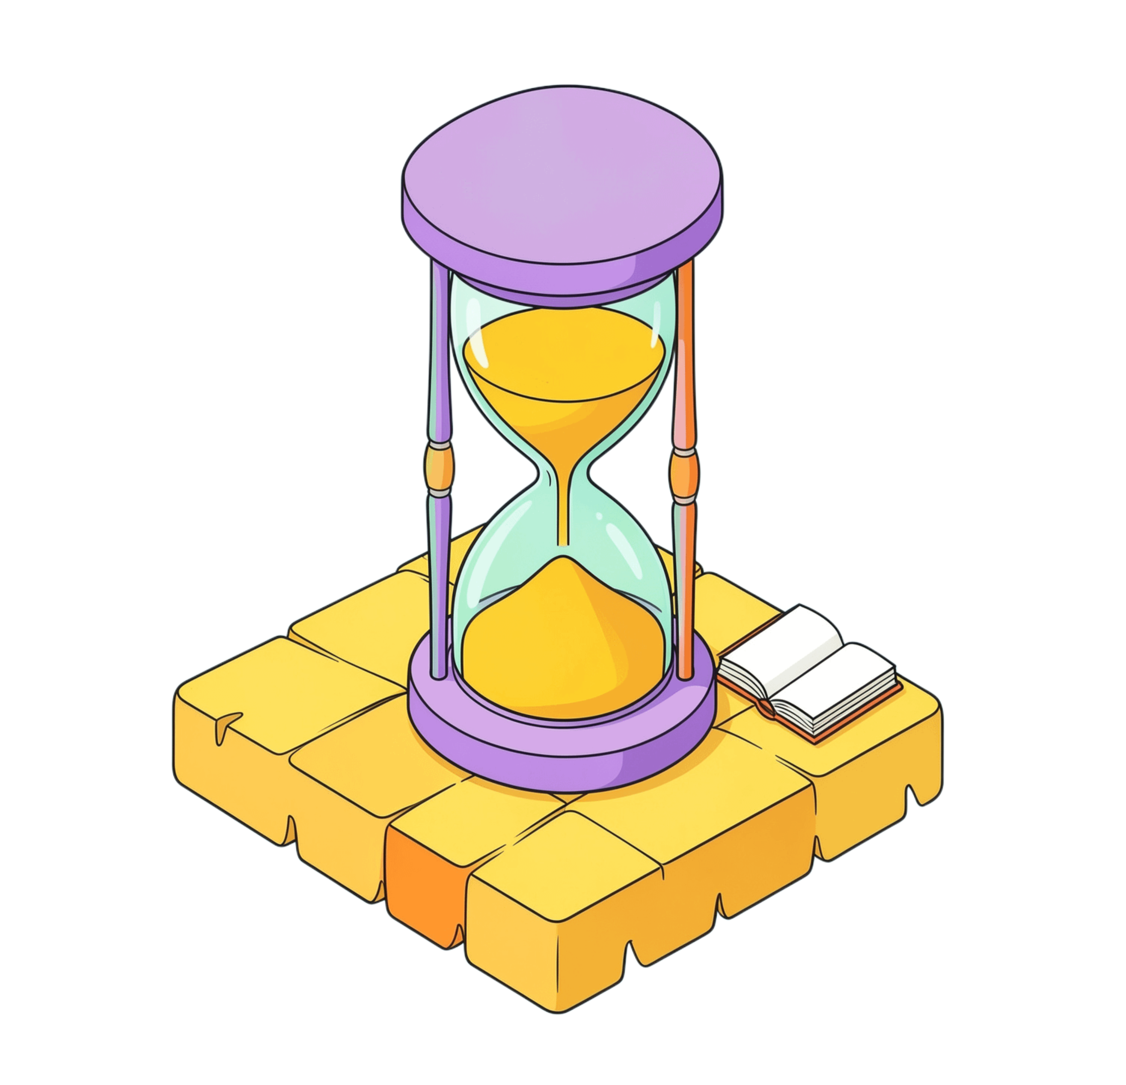
THE QUESTION
Time is every person’s most important asset
What is the most important asset for every person?
Time.
Notes:
Ask the audience the question and give them a moment to answer. The answer is time. Everyone has a limited amount of it, and every choice about learning competes for that same finite asset.

Slide 3
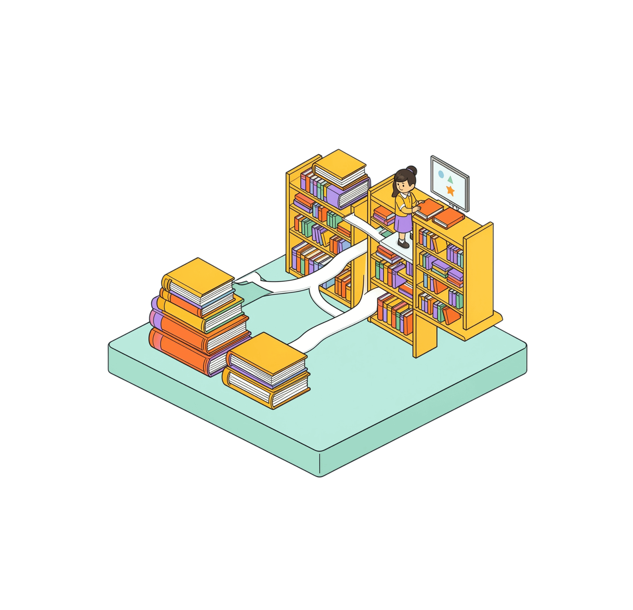
THE CHALLENGE
Knowledge has grown exponentially
What has grown exponentially over the past decades?
Knowledge.
Notes:
Knowledge is expanding at a remarkable pace. New subjects, new research, new resources, and new ways to learn are added every day. The opportunity is enormous, but the volume can also feel overwhelming.

Slide 4
THE TENSION
More to learn.
The same 24 hours.
Time is the learner’s biggest limitation. The challenge is no longer access to knowledge. It is turning limited time into meaningful progress.
Notes:
Connect the two ideas. Knowledge keeps growing, but the learner's available time does not grow with it. The biggest limitation is time, especially for students balancing classes, revision, assignments, and everyday responsibilities.

Slide 5
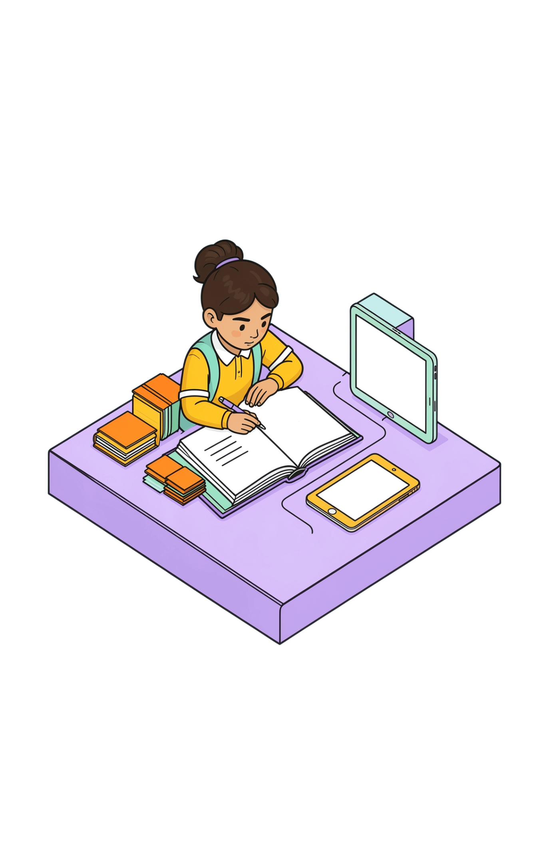
THE OPPORTUNITY
BMC Academia turns time into learning progress
One platform designed to make learning faster, easier, and more efficient.
01
02
03
Time
Knowledge
Learning
Use each study moment well.
Bring the right material together.
Move from effort to progress.
Notes:
BMC Academia brings time, knowledge, and learning together in one platform. The aim is simple: make study faster to begin, easier to understand, and more efficient to repeat.

Slide 6


THE PLATFORM
Everything students need for smarter study
Concise Notes
Flashcards
Past Questions & Solutions
Resources
Short, easy-to-understand topic summaries.
Quick and effective revision.
Connect PDFs, videos, links, and other study materials.
Practice and build confidence.
Notes:
These are the core study tools: concise notes for understanding, flashcards for revision, past questions and solutions for practice, and resources that keep PDFs, videos, links, and other materials connected.

Slide 7
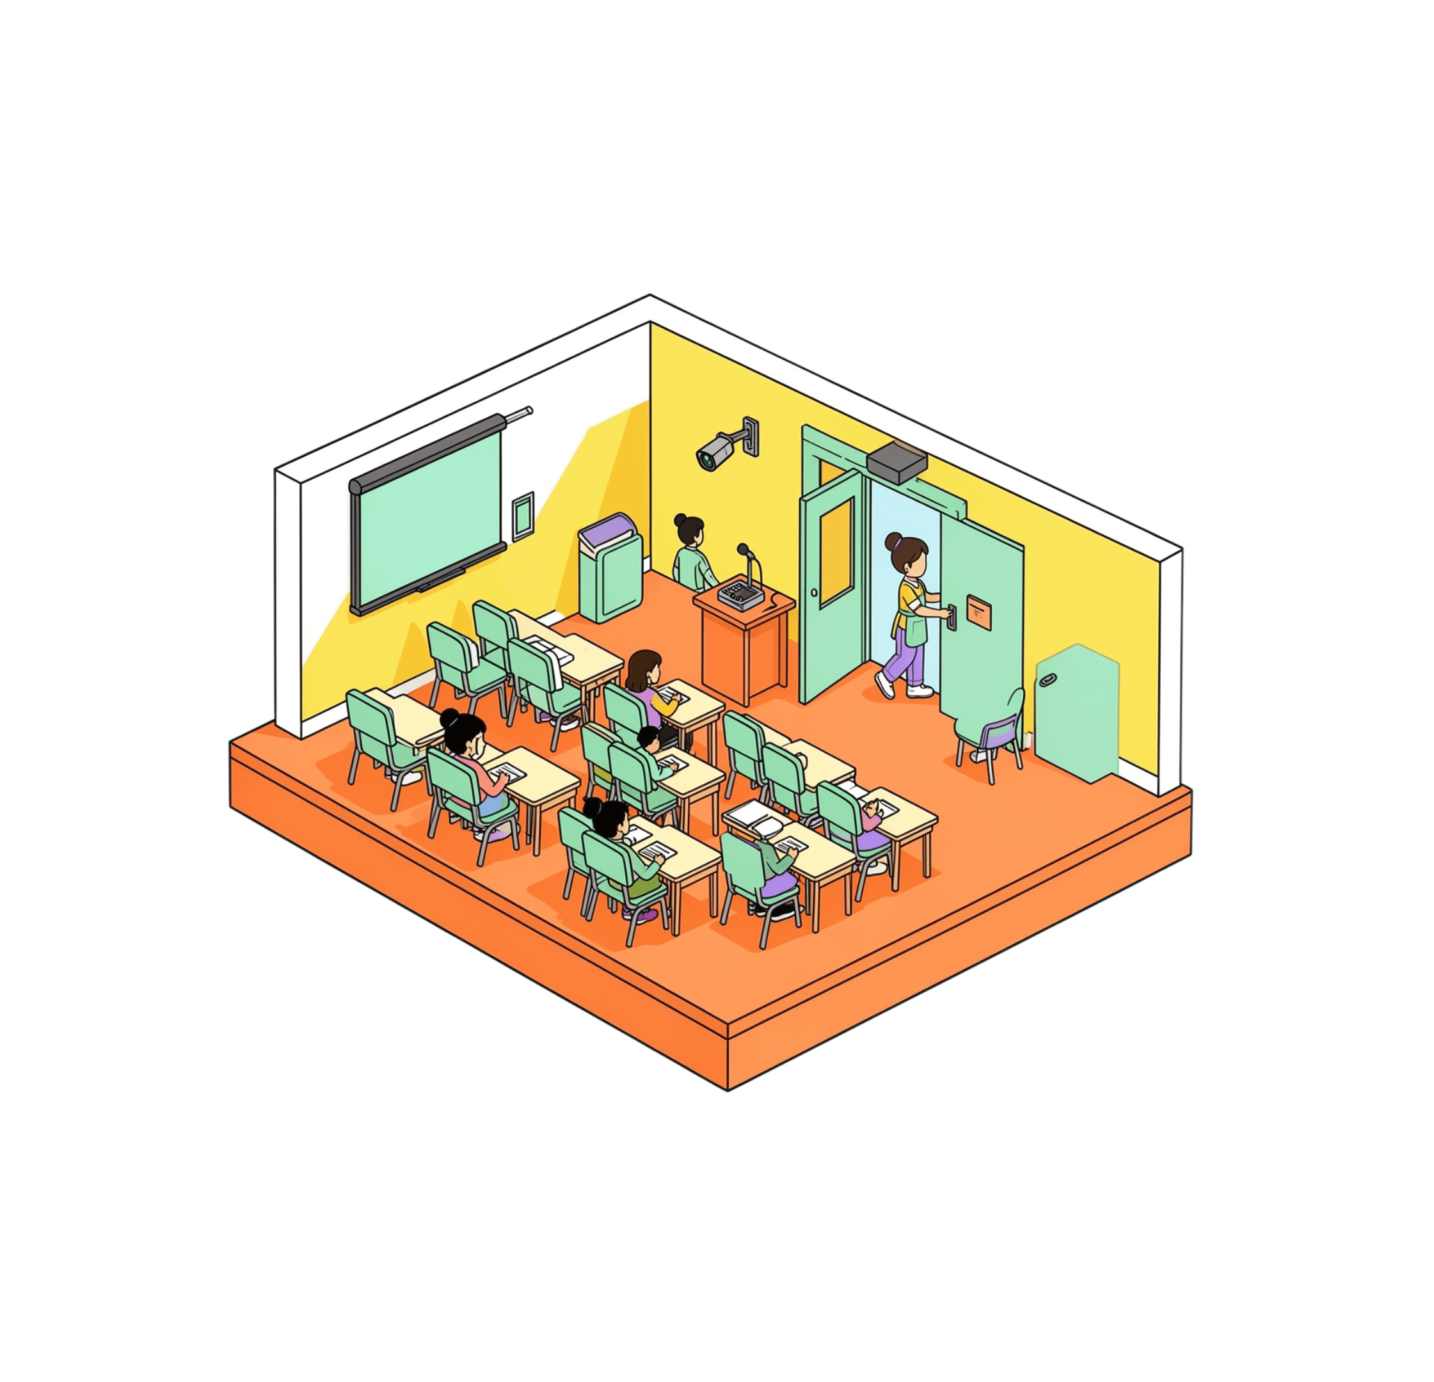
THE EXTENDED CLASSROOM
The classroom can keep teaching after class ends
01
02
03
Record
Save
Return
Capture the lecture automatically.
Keep it available for later.
Learn again whenever needed.
Notes:
The classroom does not have to stop teaching when the class ends. A smart classroom recording device can automatically record and save lectures, giving students access whenever they need it, especially when they miss class.

Slide 8


THE BUILDERS
The people building BMC Academia
[]
[Team member name]
Our team
[ROLE]
[ROLE]
Add photos and additional team members when available.
Profile photo to be added.
Profile photo to be added.
Notes:
Introduce the people building BMC Academia. The names, roles, and photos remain placeholders until the team provides the final details.

Slide 9
BMC ACADEMIA
Thank You
Questions & Answers?
We invite you to ask questions, share ideas, and help shape the future of learning at BMC.
Notes:
Thank the audience and invite questions. Encourage students, teachers, and organizers to share their questions and ideas so BMC Academia can continue to grow around real learning needs.

